Slide 1


UBSUP - DTF project - KENYA
Agricultural use of co-compost

Slide 2
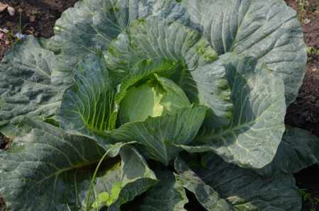
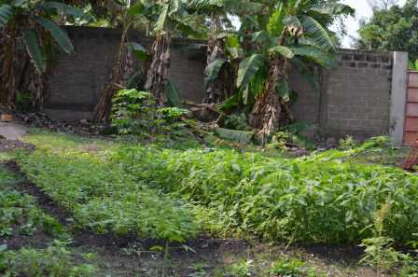
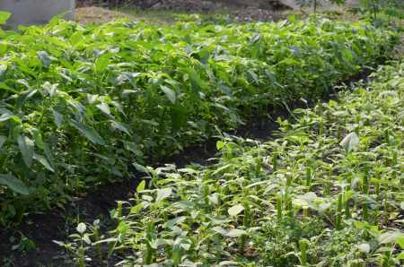
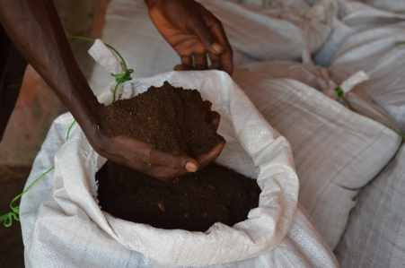

Slide 3
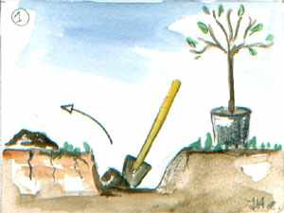


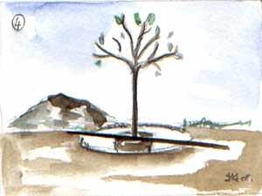
As base for planting
Trees, shrubs and bushes:
Mix 1/4 co-compost and 3/4 soil and fill the planting holes with that mix

Slide 4
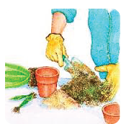

As base for planting
Flower pots and repotting:
Mix 1/3 compost and 2/3 soil. Other possibility: 1/3 co-compost, 1/3 soil and 1/3 sand

Slide 5
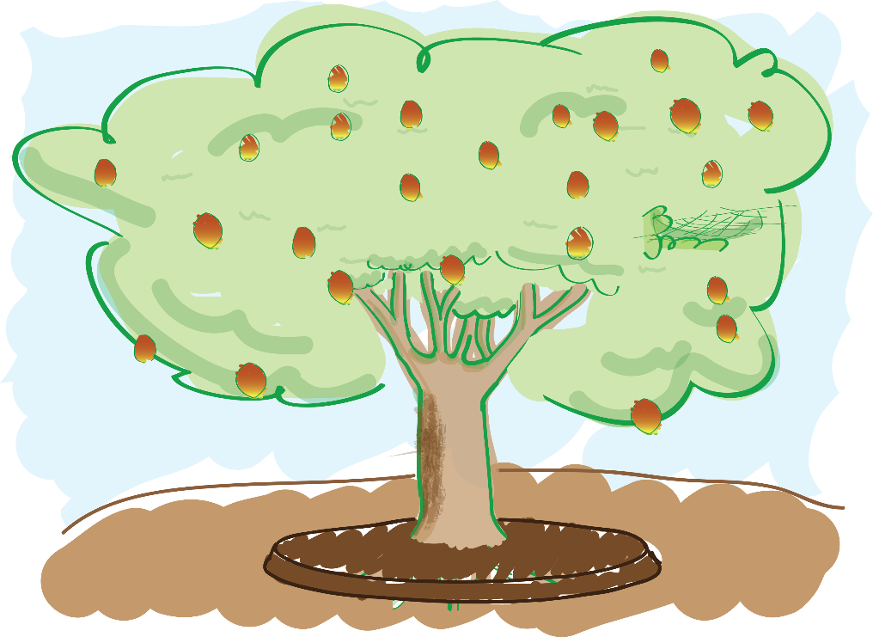
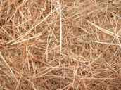
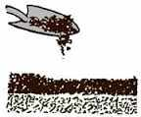
As fertilizer
Fruit trees and ornamental trees:
Lay a layer of 1cm of co-compost (2kg/m2) around the trunk and cover with straw or other mulching material

Slide 6
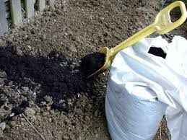
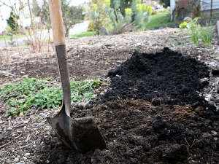
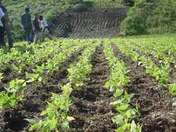
As fertilizer
Fruits and vegetables:
Can be applied in three different ways:
On the top soil with light combing to mix the co-compost with soil
Between each row of vegetable, before mulching on top
In the planting hole with a thin layer of soil to avoid direct contact of the co-compost with the seeds

Slide 7




As fertilizer
Dosage upon culture type
Tomatoes, pepper, lettuce, courgette, potatoes, corn:
High nutritional requirements → 4 kg/m2/an
Beans, carrots, spinach, beetroot, peas :
Medium nutritional requirements → 2 kg/m2/an
Cabbage, garlic, onion, herbs :
Low nutritional requirements → 0.5 kg/m2/an

Slide 8
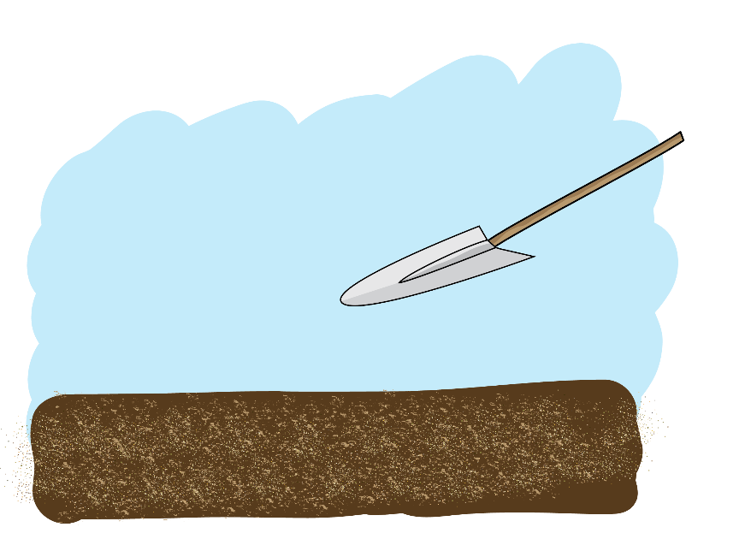
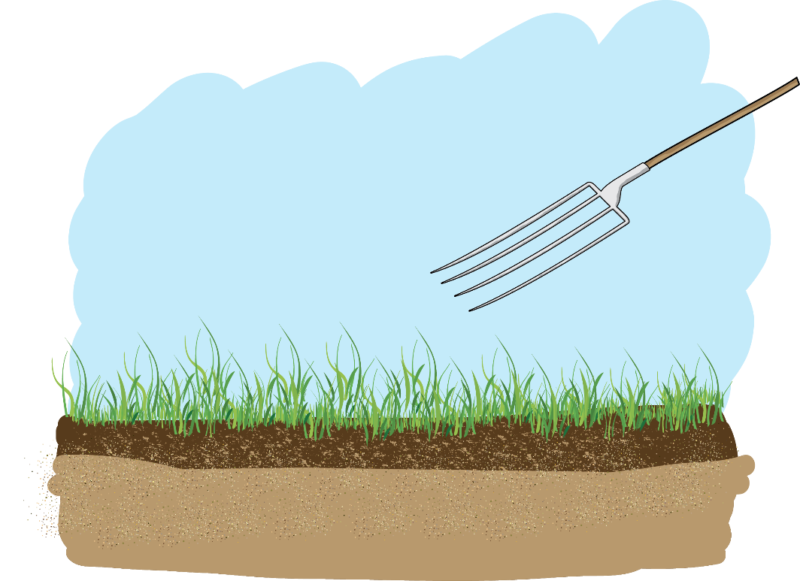
As soil conditioner
Mix the co-compost with the soil at a depth of 10 cm
Light soils or sandy soils: 12 kg/m2 every 5 years
Heavy soils: 6 kg/m2 every 3 years

Slide 9

Do you have any questions, remarks or suggestions?

